Slide 1

DEPARTMENT OF COMPUTER SCIENCE AND ENGINEERING
FOOD WASTE MANAGEMENT APPLICATION
Under the Guidance of
Mr. P SANTHOSH KUMAR
M.Tech,(Ph.D) , Assistant Proffesor
MERALA RAKESH
R190244

Slide 2
AGENDA
Abstract
Introduction
Motivation
Contribution
Modules
Module-1 (User)
Module-2 (Admin)
Module-3 (Delivery)
Future enhancements
Conclusion

Slide 3
ABSTRACT
Wasting food is a common problem in our society. This Project aims to
reduce food wastage and built an android mobile application that allows
individual users or restaurants to donate and share their foods and leftovers with
people in need.
Many restaurants tend to throw the leftover food at the end of the day
even though the food is perfectly fine to be eaten, some families can barely
afford proper meals with their limited money. Therefore, we decided to create
our application to link the restaurant with the unfortunate people, so instead of
throwing the food, the unfortunate will be able to pick it up from the restaurant
at the end of the day.

Slide 4
Existing System :
Many restaurants tend to throw the leftover food at the end of the day even though the food is perfectly fine to be eaten, which means that huge amounts of food are wasted. While all that food is being wasted, some families can barely afford proper meals with their limited money. They don't get enough nutrition due to the lack of having three meals in a day.
Therefore, we decided to create our application to link the restaurant with the unfortunate people, so instead of throwing the food, the unfortunate will be able to pick it up from the restaurant at the end of the day.

Slide 5
Proposed System :
Mobile application technology is beneficial for food waste management.
My application have many types of donating users either from organizations such as restaurants, or a family or a single user
Location facility also there, donating user should specify the location of the shared food.
Adding the time and date of each meal shared by users.
Technologies:
Frontend: Java Script, Bootstrap, HTML, CSS
Control end: Angular JS
Backend: PHP, MYSQL( Database )

Slide 6
Introduction
The Main concept of this project Food Waste Management is to collect the excess/ leftover food from donors such as hotels, restaurants, marriage halls, etc.. and distribute to the needy people .
All the food that restaurants and hotels have left over at the end of the day even though the food is perfectly fine to be eaten, which means that huge amounts of food are wasted. . Meanwhile, there are many families who can't afford to buy enough food. Our project, the Food Waste Management Application, helps to connect these two groups.
Restaurants and other places with extra food can use our application to let people know they have food to give away. Families and organizations that need food can then find and pick it up easily.We've built this app using modern technology like JavaScript and PHP. It helps make sure good food doesn't go to waste and gets to people who really need it.

Slide 7
Motivation :
Help the Environment: Throwing away food wastes resources like water and energy and creates harmful gases that contribute to climate change. By reducing food waste, we can help protect the environment.
Save Money: Wasting food also means wasting money. For restaurants and households, this can be a financial burden. Our app helps make sure that food is used and shared, saving money in the process.
Support People in Need: Many people don’t have enough to eat while perfectly good food is being thrown away. Our application connects people who have extra food with those who need it, helping to reduce hunger.
Build Community: This project encourages people to work together and support each other. By sharing food, we can create a stronger sense of community.
Future Growth: This app is just the beginning. With future updates, it can become even better, helping to reduce food waste on a larger scale.

Slide 8
Contribution :
Front End Development: Create the user interface using HTML5, CSS3, and Bootstrap. Make sure the app looks good and is easy to use.
Back End Development: Set up the server and database using PHP and MySQL. Ensure that the app can store and manage user data and food listings.
Control End Development: Use Angular JavaScript to handle the logic and interactions of the app, making sure everything works smoothly.
User Interface Design: Design the layout, colors, and overall look of the app to make it attractive and user-friendly.
Database Management: Set up and maintain the SQL storage and real-time database. Ensure that all data is stored securely and can be accessed quickly.

Slide 9
Modules
Module 1 : USERS
The User module is designed for people who wish to donate their excess or leftover food to help reduce food wastage . The User module is responsible for accepting food donations from users who have excess food, such as marriage halls, restaurants, or individuals . The module provides users with the ability to register, login, and donate food. Users can select the type and quantity of food they want to donate, and the system will match their donation with the nearest needy people or organizations . The module also allows users to view their donations . The User module provides the information to the Admin module for further processing.
Registration and Login: Users can register with their details and log in using their credentials
Food Donation: Users can donate food by selecting the type and quantity. The system matches their donation with the nearest needy people or organizations.
View Donations: Users can view their donation history.

Slide 10
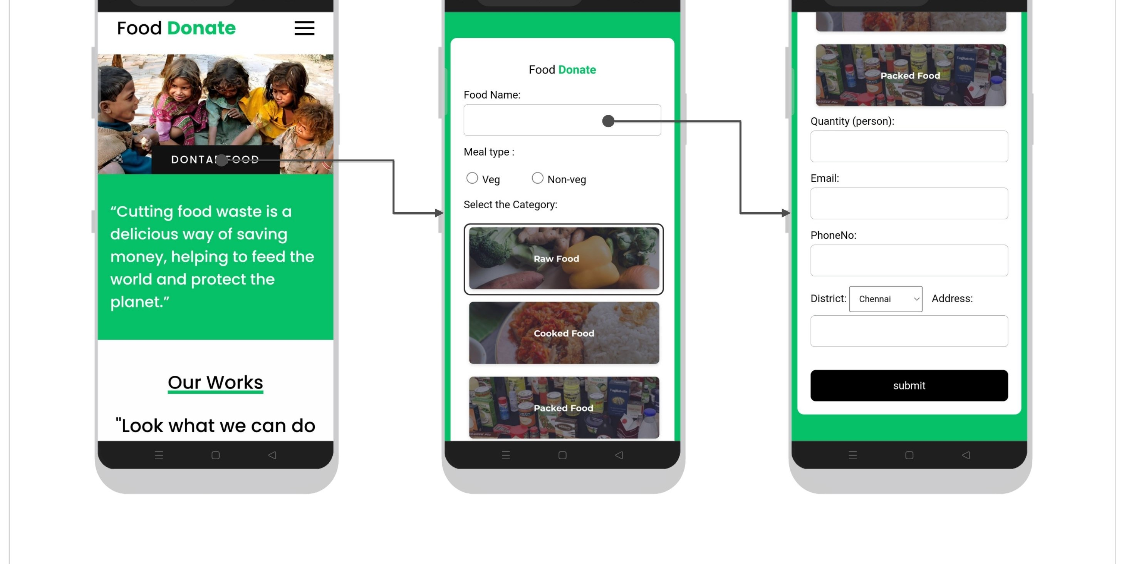

Slide 11
Module 2 : ADMIN
The Administrator module is for trusts, NGOs, and charities that are registered on the platform. The Admin module is designed for system administrators who manage the food distribution process. The Admin module receives information about the food donation from the User module and lists it for NGOs and charities to choose from.Admins can view and manage the list of donations received, including the type and quantity of food donated. NGOs and charities can select the food donation they need from the Admin module and request a pickup to the Delivery module.The Admin module is responsible for tracking the requests and keeping track of which organizations have taken which donations.
Receiving Donations: The Admin module receives information about food donations from the User module.
Managing Donations: Admins can view and manage the list of donations received, including the type and quantity of food donated.
Distribution to NGOs/Charities: Registered NGOs and charities can select the food donations they need from the Admin module and request a pickup through the Delivery module.
Tracking Requests: The Admin module tracks the requests and keeps records of which organizations have taken which donations.

Slide 12
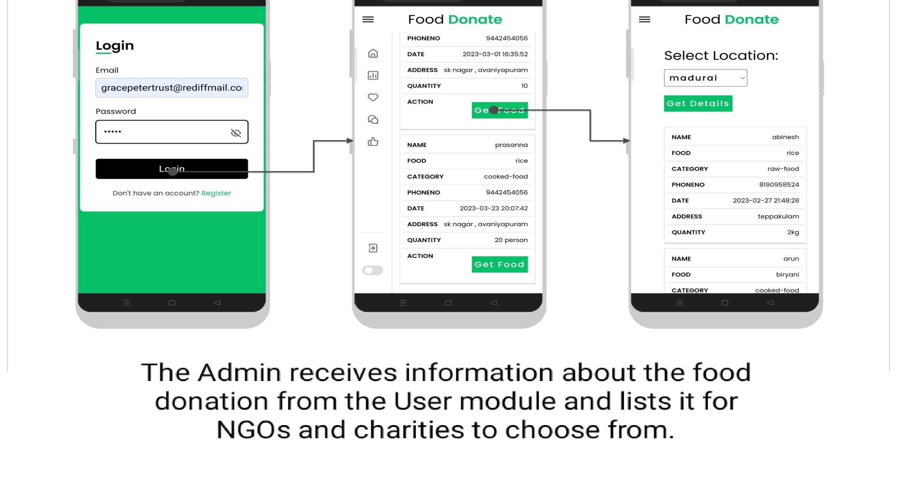

Slide 13
Module 3: Delivery
The Delivery Person module is for individuals who wish to participate in the food donation process by providing pickup and delivery services. Delivery personnel can register themselves on the platform .The Delivery Person module provides pickup and drop-off services for NGOs and charities who have requested a food donation.The Delivery Person module shows the pickup location and drop location of the food donation.
Registration: Delivery personnel can register themselves on the platform.
Pickup and Delivery Services: The module provides pickup and drop-off services for NGOs and charities that have requested a food donation.
Location Information: The module shows the pickup location and drop-off location of the food donation.

Slide 14
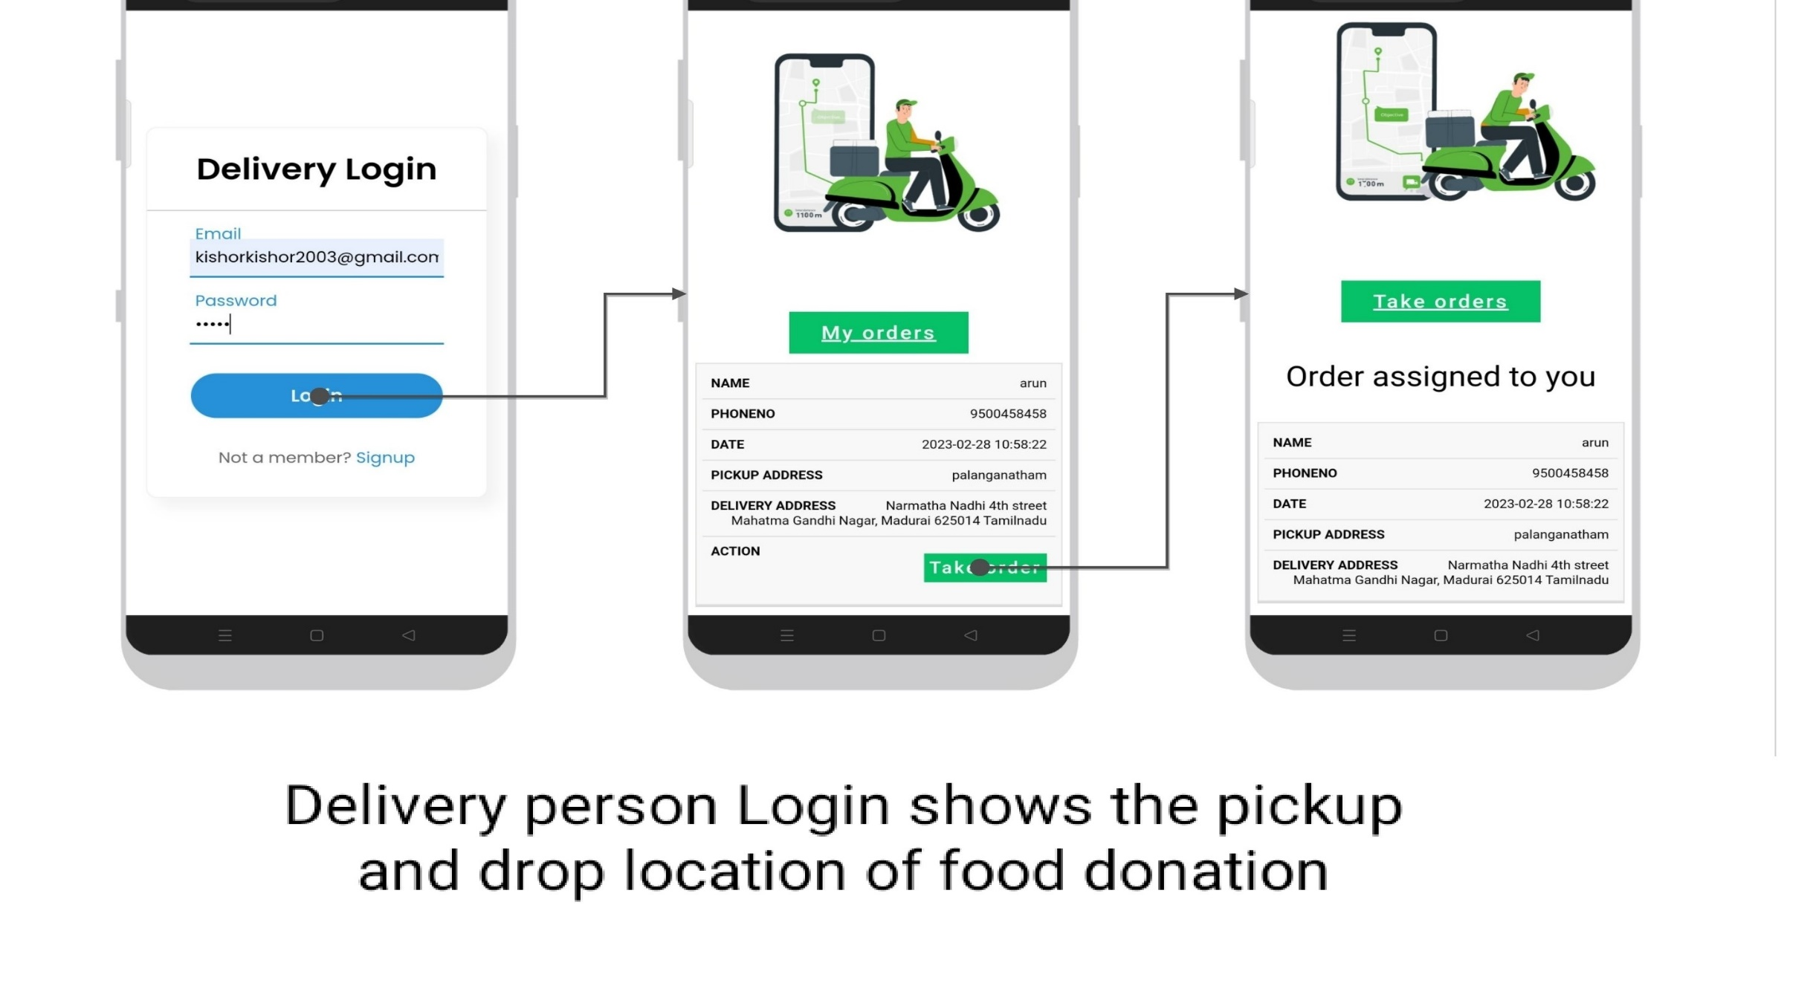

Slide 15
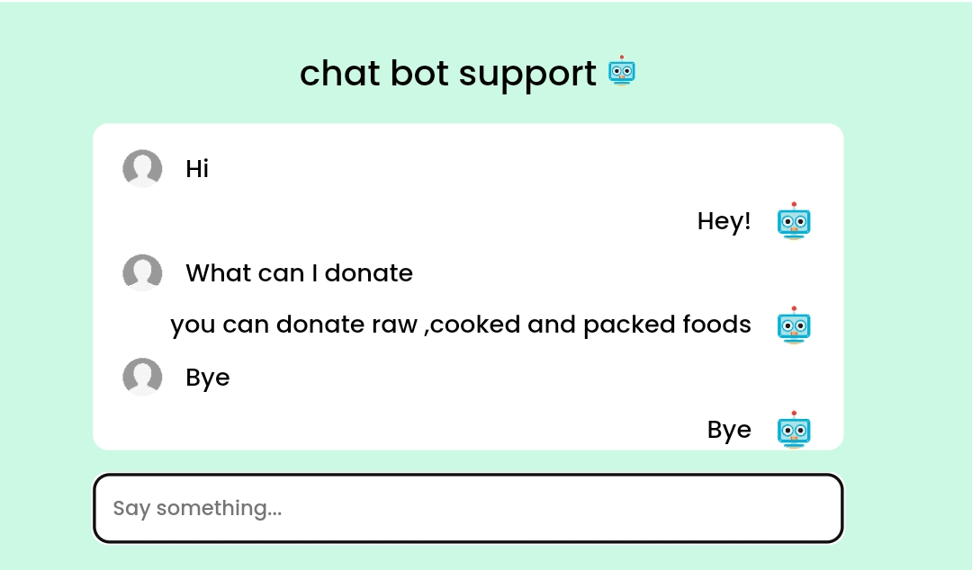
Chat Bot Support
The Chatbot Support module offers real-time assistance to users. It helps with registration, donation process, and troubleshooting. The chatbot answers common questions, providing quick and efficient support.

Slide 16
Future enhancements
1. More Types of Users:
Various Donors: We want to include not just restaurants but also families and individuals as donors. This way, anyone with extra food can contribute.
Different Recipients: We plan to include a variety of organizations that can receive food, such as shelters and community kitchens.
2. Better Location Features:
Find Food Easily: We’ll add features that let users specify where the food is located using GPS. This will help people find and pick up food more easily.
Maps: We’ll integrate maps so users can see where donations are coming from and plan their pickups better.
3. Cross-Platform Support:
Multiple Devices: We aim to develop versions of the app for both iOS and Android phones, and possibly a web version, to reach more people.
4. Improved Search and Notifications:
Find What You Need: We’ll add advanced search options so users can easily find the type of food or donation they are looking for.
Custom Alerts: Users will be able to set up notifications for specific types of donations or locations.

Slide 17
Conclusion
In conclusion, the Food Waste Management System is designed to efficiently manage excess food and ensure that it is distributed to those in need. The User module accepts food donations, the Admin module lists them for NGOs and charities to choose from, and the Delivery Person module provides pickup and drop-off services. This system benefits the community by reducing food waste and helping those in need.

